Slide 1
Advanced Design and Programming
Prof. Dr. Dirk Riehle
Friedrich-Alexander University Erlangen-Nürnberg
ADAP A01
Licensed under CC BY 4.0 International
Notes:
It is Friedrich-Alexander University Erlangen-Nürnberg – FAU, in short.
Corporate identity wants us to say “Friedrich-Alexander University”.

Slide 2
Course Learning Goals
To acquire competence in ...
  domain-independent
  principles and practices of
  advanced object-oriented
  design and programming

Slide 3
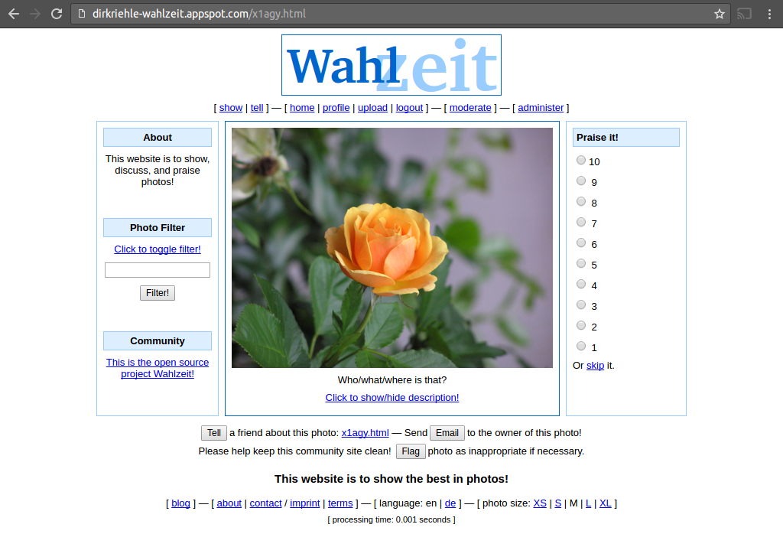
Wahlzeit / Flowers Application

Slide 4

Student Choice of Project 1 / 2
[1] Photos courtesy of Wikipedia with various CC licenses

Slide 5
Student Choice of Project 2 / 2
Choose something that will provide you with domain classes
  Food → Type of food, price, location
  Landscapes → Location, season, camera
  Postage stamps → Stamp, country, age
You will need these domain classes for your homework

Slide 6
Skills Required for Course
Required prior student skills
  Programming in Java
  Working with git
Familiar with at least one
  Operating system (default: Linux)
  Command line (default: bash)
  Development environment (default: Eclipse)
Expected of student
  Willingness to learn by themselves

Slide 7
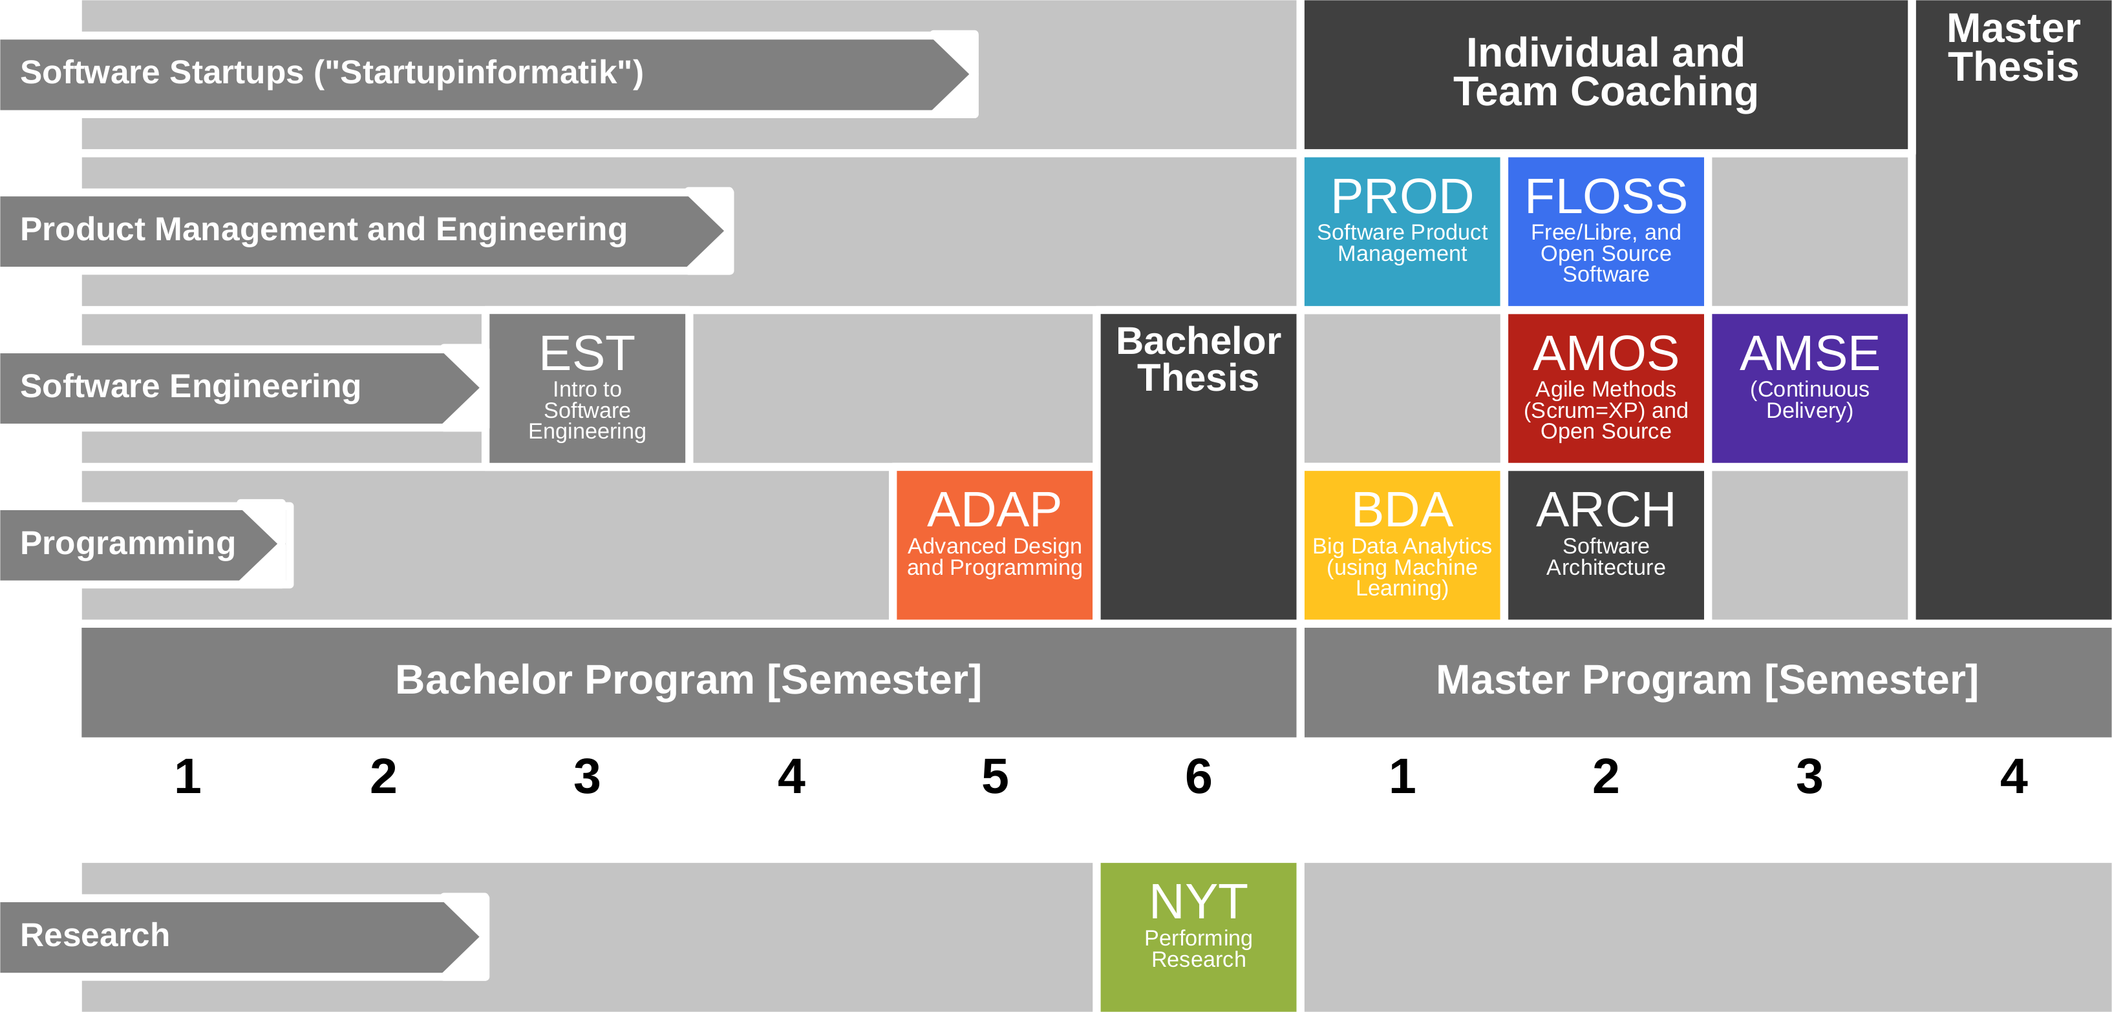
Course Position in Curriculum

Slide 8
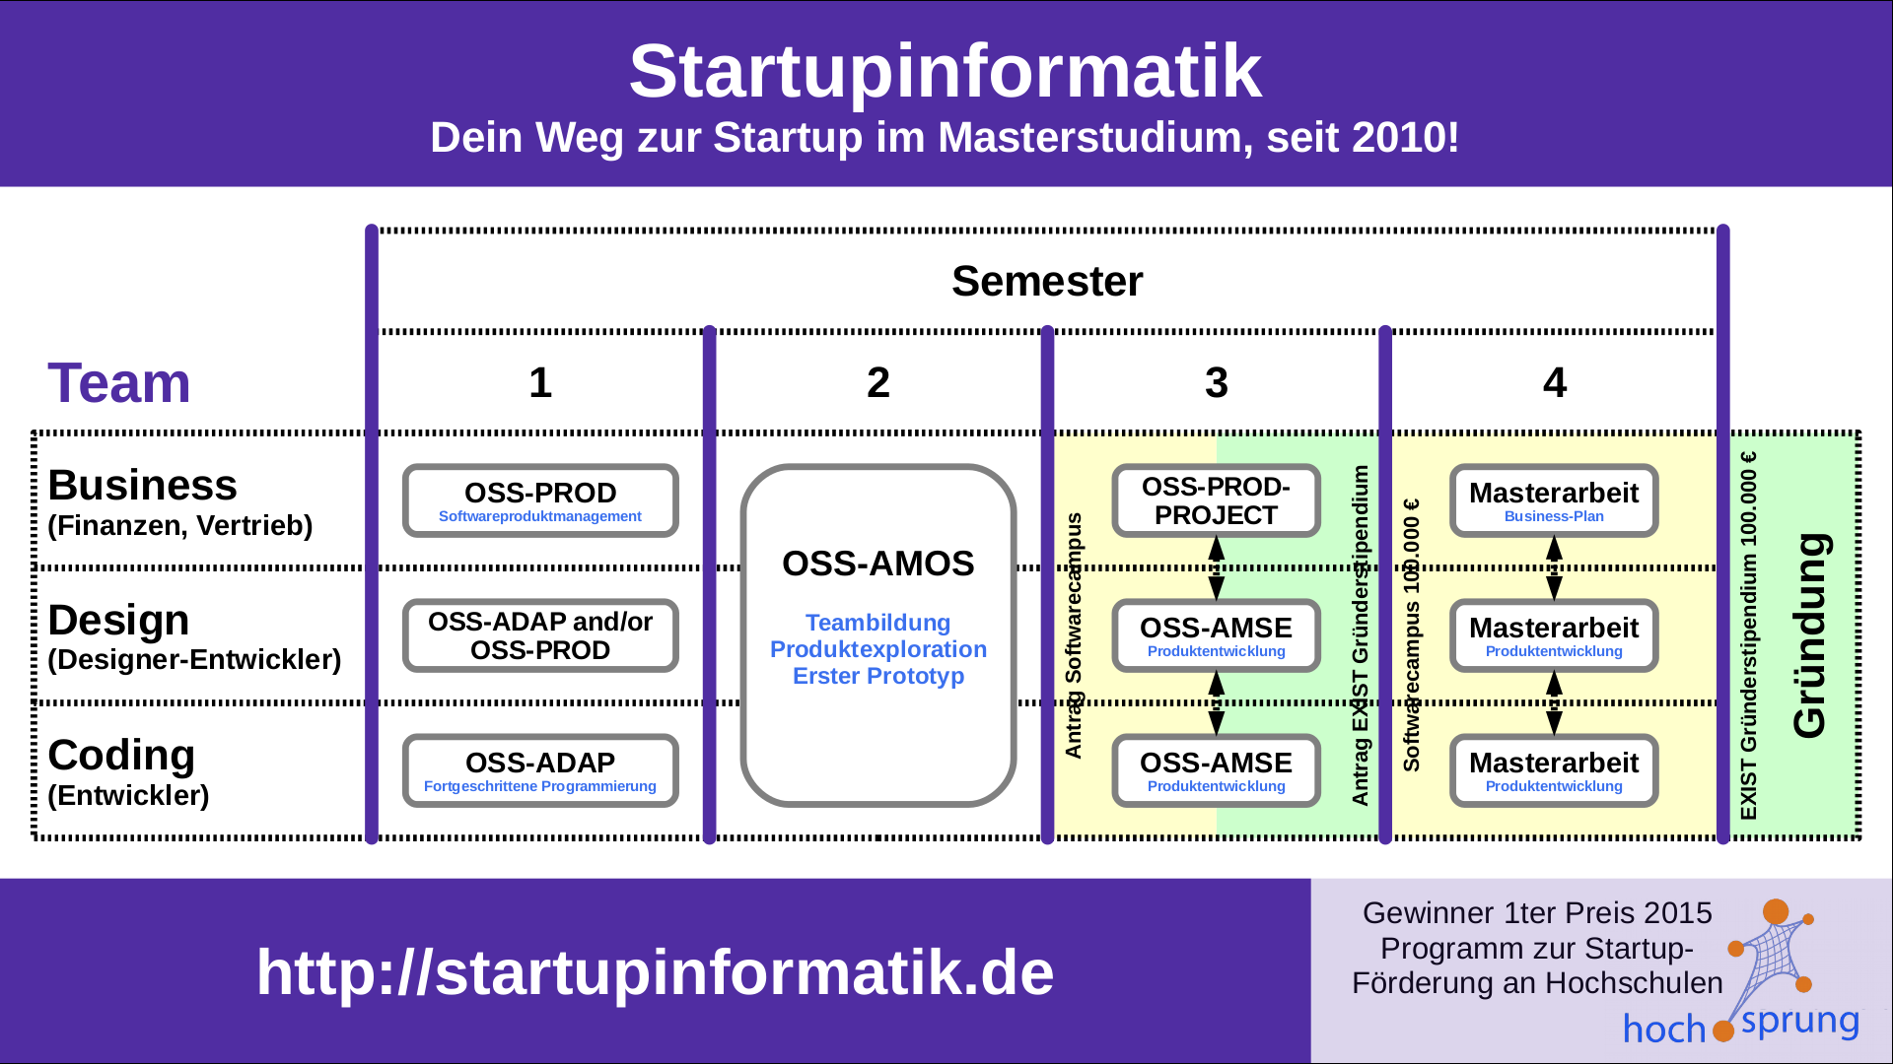
ADAP is Part of Startupinformatik

Slide 9
Courses and Modules
NYT can be taken as
  5 ECTS VL + UE
  5 ECTS Seminar
  10 ECTS VL + UE
  10 ECTS Project
In various degree programs
Also as a Schlüsselqualifikation
 |  | Courses (Lehrveranstaltungen)
 |  | OSS-ADAP-VUE |  | Total ECTS
Modules | OSS-ADAP | x |  | 5
VUE = Lecture + exercise (Vorlesung + Übung)
PROJ = Project

Slide 10
Course Grading [1]
Understanding of lecture content (2 SWS) = 30 / 150 = 20%
  Graded using [0..10] each class session using StudOn quizzes
Understanding of exercises (2 SWS) = 30 / 150 = 20%
  Graded using [0|1|2|3] scheme evaluated using active participation
Homework assignments = 90 / 150 = 60%
  Graded using [0..10] each
[1] Also see http://osr.cs.fau.de/teaching/course-resources/grading-schemes-and-scales/

Slide 11
Course Grading [1]
Understanding of lecture content (2 SWS) = 30 / 150 = 20%
  Graded using [0..10] each class session using StudOn quizzes
Understanding of exercises (2 SWS) = 30 / 150 = 20%
  Graded using [0|1|2|3] scheme evaluated using active participation
Homework assignments = 90 / 150 = 60%
  Graded using [0..10] each by course instructors
[1] Also see http://osr.cs.fau.de/teaching/course-resources/grading-schemes-and-scales/

Slide 12
Class Quizzes
Each class session starts with a class quiz
  A quiz will test your understanding of last session’s lecture(s)
  A quiz typically has 5 questions and will last 10 minutes
  The overall quiz is graded using [0..10] scheme (10 points in total)
A class quiz will open precisely when class starts
  The quiz is administered automatically through StudOn
  It is your job to have reliable Internet access etc.
  There is no way to make up for a missed quiz

Slide 13
Active Participation
Showing up +
listening to the lecturer +
thinking about what you are hearing +
verbalizing your thoughts (speaking up) +
answering to someone else's thoughts +
collaborating to solve a problem +
adequate use of air-time

Slide 14
Homework Grading
Categories | Points |  |  |  |  | Criteria
 | Disagree | Disagree some | Neutral | Agree some | Agree
Form (10%) | Does the deliverable meet formal requirements? |  |  |  |  | Does the deliverable meet page length requirements, has the right language, has required header, etc.?
Language (10%) | Is the language clear, concise, and helpful? |  |  |  |  | Are sentences complete, is the grammar correct, are statements coherent, etc.?
Solution Design (30%) | Does the solution make sense and is it explained well? |  |  |  |  | Is the answer clear, is it explained why it was chosen, are pros and cons weighed, etc.
Solution Imple-mentation (50%) | Has the solution been implemented well? (If no implementation was required, use your explanation points for the implementation as well.) |  |  |  |  | Is the code clean, follows coding guidelines, is well tested, matches explanation, etc.?

Slide 15
Requirement for Passing Course
At least 50% participation in all grade-relevant components
  Class quizzes
  Active participation
  Homework submissions

Slide 16

No Oral or Written Exam [1]
[1] You still have to register for the course

Slide 17
Course Language [1]
Class
  Lecturer: German
  Student: Choice of German or English
Homework
  Source code: English
  Submissions: Choice of German or English
[1] See http://osr.cs.fau.de/2012/03/10/english-or-german-deutsch-oder-englisch/

Slide 18

Course Communication
Announcements by email (through StudOn)
Questions and answers using FSI Forum for course

Slide 19
Open Source Governance
Do not add reciprocally-licensed libraries to your project
  May make later desired license change difficult, including proprietary use
  Check with osr-adap@group.riehle.org whether library is OK
Rules of thumb on license choice
  OK: Permissive licenses (BSD, MIT, Apache)
  May be OK: Weakly protective (a.k.a. “weak copyleft”)
  Usually not OK: Strongly protective (a.k.a. “reciprocal” or “copyleft”)
  Never OK: Public domain or no license
Professionals (i.e. companies) use code scanners to check
  Black Duck, Palamida, Protecode, ...

Slide 20
Project Contributor Agreement
For contributions to Wahlzeit, we require a rights grant
  We use the Sun Contributor Agreement
    Available here: http://osr.cs.fau.de/teaching/contributor-agreement/

Slide 21
Course Information
Step 1: Course index
  https://goo.gl/H9Zcmy
For everything else, see Step 1

Slide 22
Thanks! Questions?
dirk.riehle@fau.de – http://osr.cs.fau.de
dirk@riehle.org – http://dirkriehle.com – @dirkriehle
DR

Slide 23
Credits and License
Original version
  © 2012-2018 Dirk Riehle, some rights reserved
  Licensed under a Creative Commons Attribution 4.0 International License
Contributions
  ...

